Slide 1
Limbaje formale si automate
Seria 13
Saptamana 9, 21 apr 2020
Andrei Paun

Slide 2
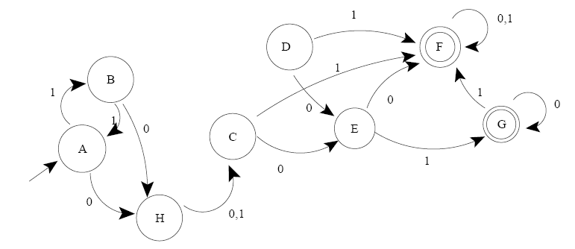

Slide 3
